Slide 2
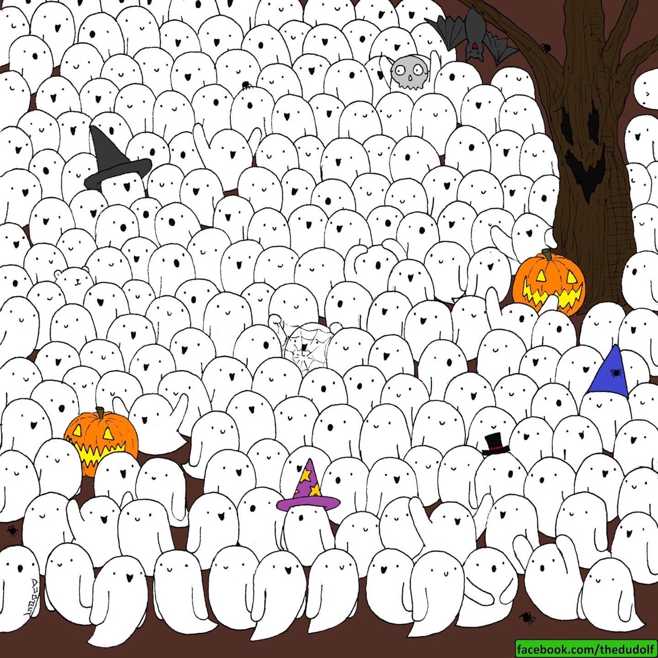
Spot a polar bear among the ghosts

Slide 3
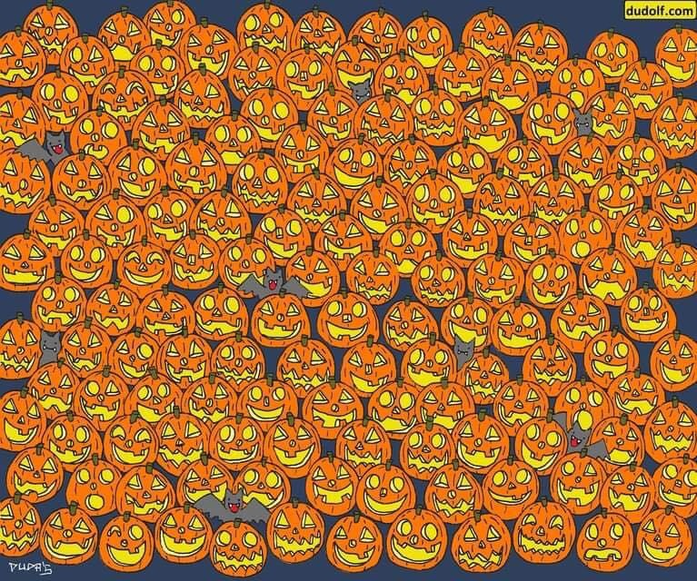
Spot the Jack-o-lantern with NO NOSE

Slide 4
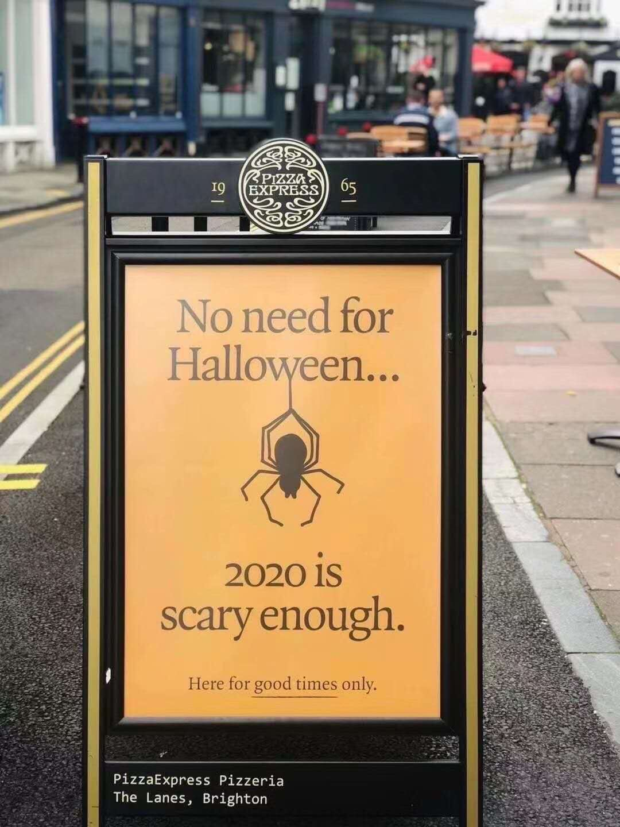
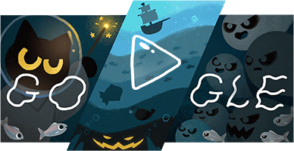

Slide 5
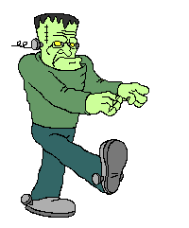
Did you do your homework?
Yes! Yes!
Of course!

Slide 6
jump
dance

Slide 7
jump
draw

Slide 8
jump
fly

Slide 9
jump
jump

Slide 10
swim
read

Slide 11
swim
sing

Slide 12
swim
swim

Slide 13
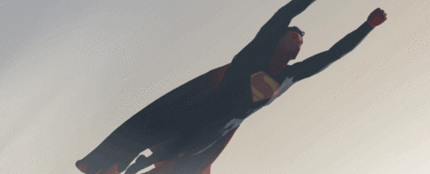
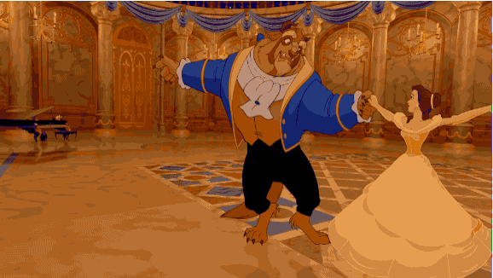
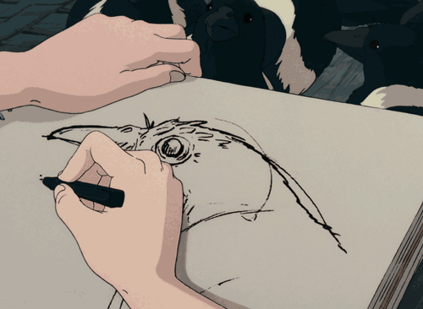
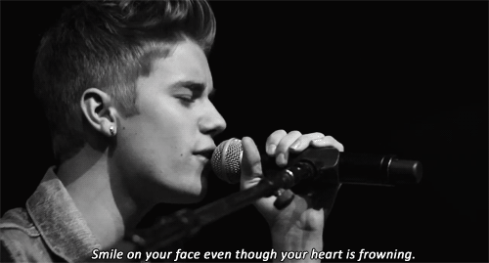
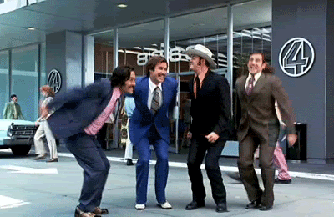
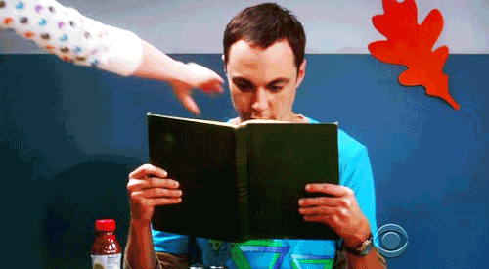
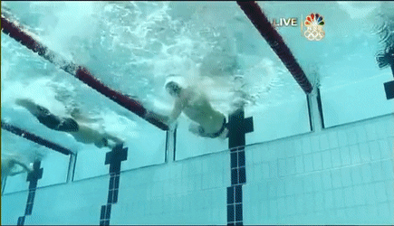
1
2
draw
3
fly
dance
4
5
6
7
jump
read
sing
swim

Slide 14
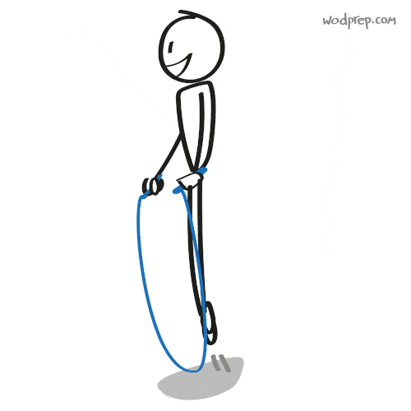
Can you jump?
Yes, I can.
I can jump.

Slide 15
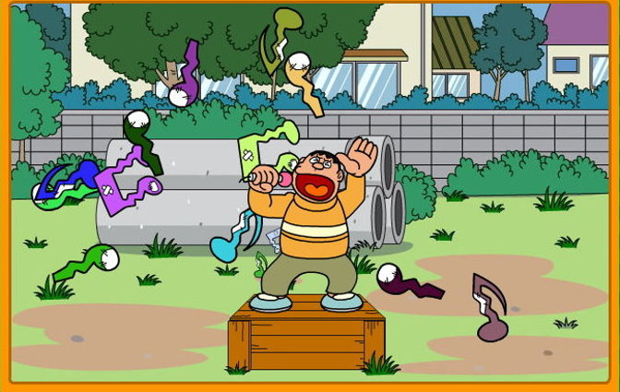
Can he sing?
No, he can’t.
He can’t sing.

Slide 16
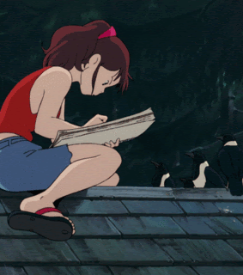
Can she draw?
Yes, she can.
She can draw.

Slide 17
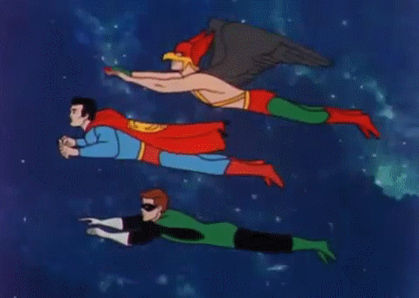
Can they fly?
Yes, they can.
Because they are superheroes.

Slide 18
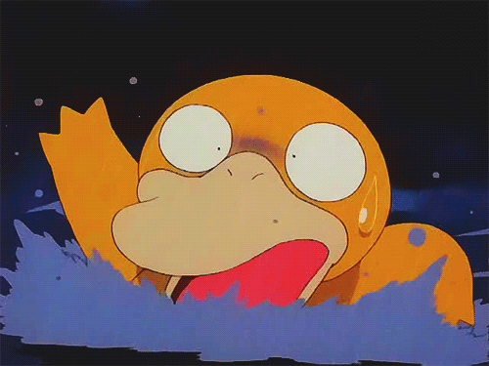
Can Psyduck swim?
No, it can’t.
It can’t swim.

Slide 19
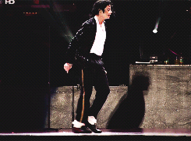
Can Michael Jackson dance?
Yes, he can.
He’s a dancing king.

Slide 20
Can she read?
No, she can’t.
She feels
frustrated.

Slide 21
Daily Talk
Watch out!

Slide 22
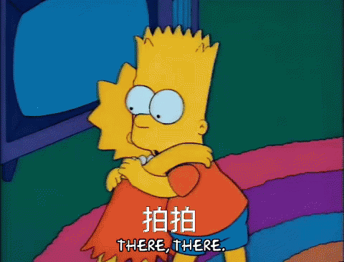
Daily Talk
Are you OK?

Slide 23
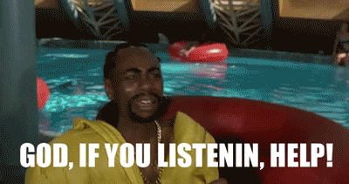
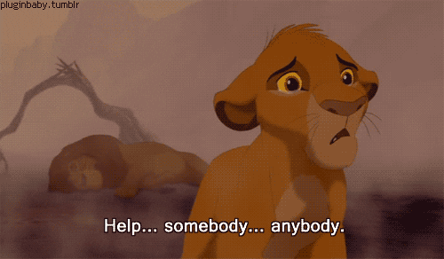
Daily Talk
Help!

Slide 24
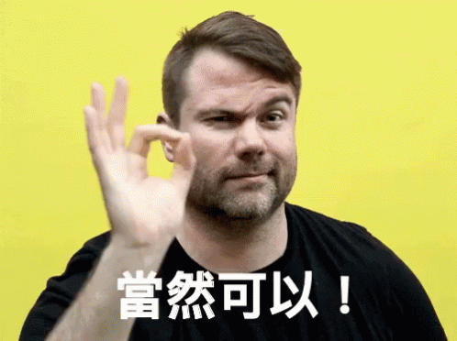
Daily Talk
Of course!

Slide 25
P32~P33

Slide 26
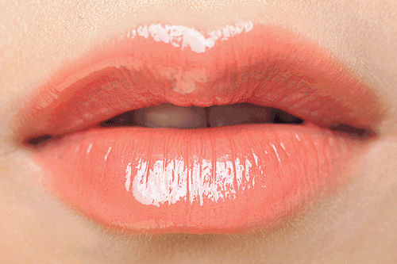
ip
l

Slide 27
s
ip

Slide 28
z
ip

Slide 29
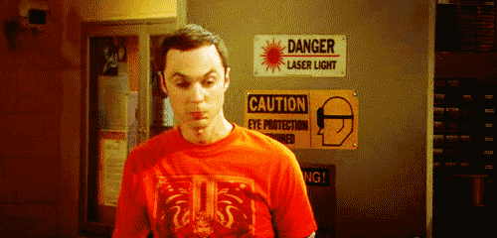
Zip your lip.

Slide 30
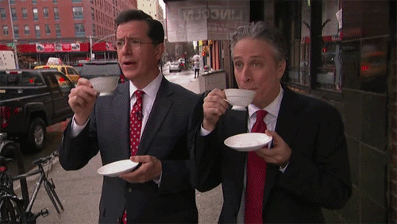
Sip your tea.

Slide 31
Zip your lip and sip your tea.

Slide 32
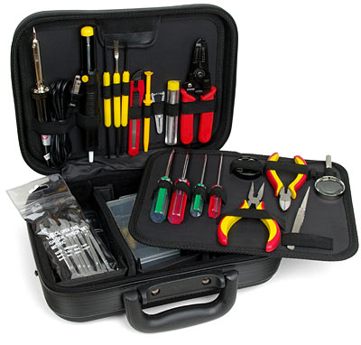
k
it

Slide 33
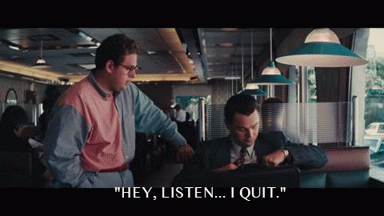
qu
it

Slide 34
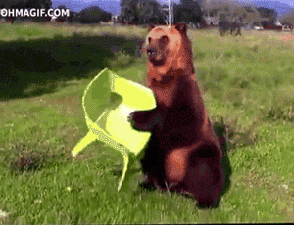
s
it

Slide 35
Don’t quit.

Slide 36
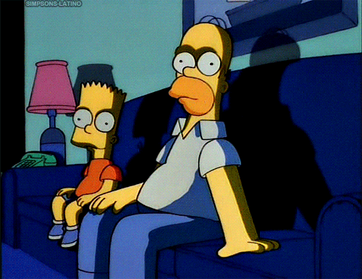
Sit for a bit.

Slide 37
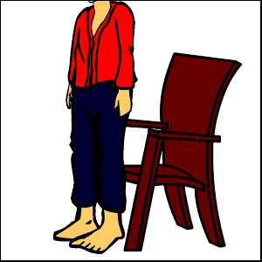
You can sit by the kit.

Slide 39
am
en
it
an
ell
ip

Slide 41
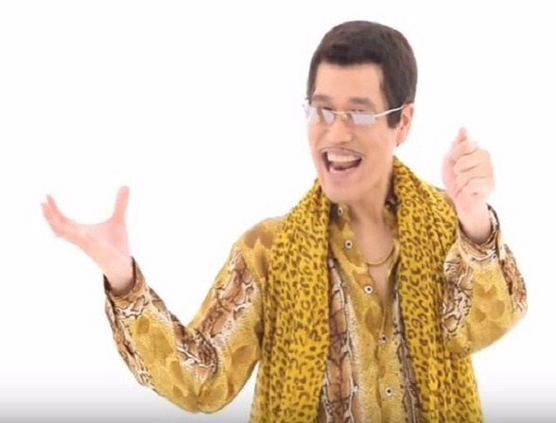

Slide 42
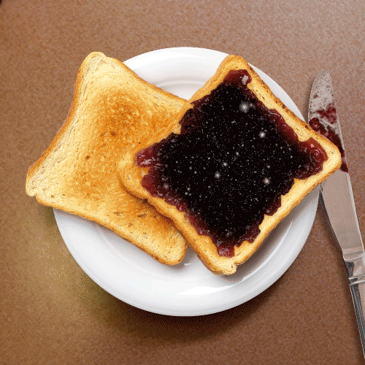

Slide 44
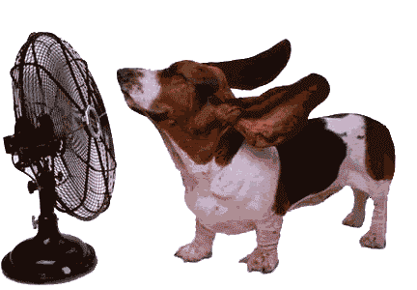

Slide 47
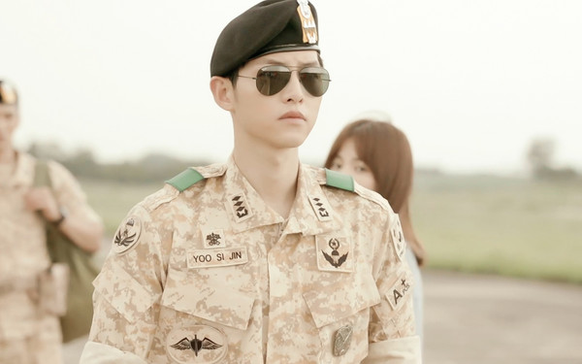

Slide 48
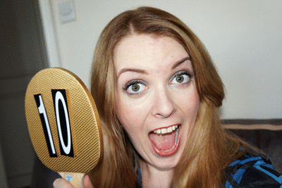

Slide 49
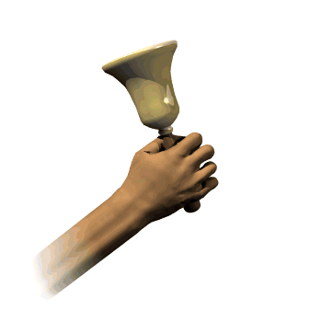

Slide 50
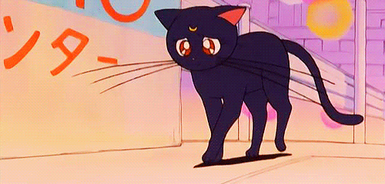

Slide 51
